Slide 1

Gokaraju Rangaraju Institute of Engineering and Technology (Autonomous) Department of Artificial Intelligence and Machine Learning Engineering
Automated Word Formatter
Under the Guidance of:
Dr. M. Kiran Kumar,
Associate Professor, Dept of AIMLE
Presented by:
1. Mr. N. Krishna Kalyan (20241A6638)
2. Mr. A. Abhinav (20241A6605)
3. Mr. Samuel (20241A6647)

Slide 2
Introduction
Document formatting covers the layout and visual presentation of content on a page, including font selection, size, styles , spacing, margins, alignment, columns, indentation, and lists.
Proper formatting is crucial for maintaining consistency, accuracy, and readability in a document, as it greatly influences how readers perceive the information.
Attention to formatting is essential in any form of written or documented work to enhance accessibility and user understanding.

Slide 3
Key aspects of effective formatting include the use of headings to structure content, the application of formatting styles (e.g., bold, italics) to highlight important terms or ideas, and the choice of an appropriate font to convey a professional appearance.
Introduction​(Cont.)

Slide 4
Objective of the Project
To Implement a python based word formatting tool which automates manual editing to save time and effort.
The approach used is to classify the elements of the document.
Applying a pre-defined style to the categorized elements through manipulation of the Document Tree Structure.

Slide 5
Existing Approaches (Literature Survey)
Ref. No | Title | Methodology | Advantages | Drawbacks
[1] | Automated formatting verification technique of paperwork based on the gradient boosting on decision trees | It is a classification technique which uses a decision tree algorithm to classify elements of document there by applying the predefined style to the document . | Utilizes machine learning algorithms, specifically gradient boosting on decision trees improving performance | It only checks the errors in documents but it doesn’t edit the document automatically.
[2] | An Implementation Approach Towards The Automation Of Document Formatting Using Python | This approach is based on the usage of docx, regex and difflib library's present in python which are used to classify every element as either correct or wrong. | Provides user friendly experience and reducing the risk of document rejection and improving overall document quality. | Lack of template customization options and does not predict mathematical equations.

Slide 6
Existing Approaches (literature survey)
Ref. No | Title | Methodology | Advantages | Drawbacks
[3] | Machine Learning Approach to Automated Correction of LATEX Documents | This method uses groups with a tree pattern and group rules to identify potential errors. | It uses Zhang-Shasha algorithm to Correct a wide range of errors including syntax errors, style errors, and formatting errors. | Can wrongly identify a correct statement to avoid such errors a large amount of computational resources are required
[4] | Two Algorithms for Automatic Document Page Layout | The first approach uses a bounding box method. The second approach is a places items in free form | Recursively divides the document into pages. Places the document items on the pages according to a set of heuristics there by pruning entire traversal | The algorithms are highly dependent on the input quality of the document. The approach doesn’t provide good results on tables and image data.

Slide 7
Existing Approaches (literature survey)
Ref. No | Title | Methodology | Advantages | Drawbacks
[5] | Review of Automatic Document Formatting | This survey explains about techniques such as Column-driven layout ,Cell-driven layout selection methods | It provides accurate formatting as this approach modifies the tree structure of the document. | It does not use any machine learning approach to automate document formatting it uses the tree structure of the document to edit formatting
[6] | Web Application for generating a Standard Coordinated Documentation for CS Students | Implemented using Django framework and MySql Database. | Interactive web interface making it convenient for users. | It only provides template for a specific student template.

Slide 8
Existing Approaches (literature survey)
Ref. No | Title | Methodology | Advantages | Drawbacks
[7] | Optimal Automatic Table Layout | It uses A* algorithm approach Constraint Programming Approach 1 Constraint Programming Approach 2 with Lazy Clause Generation | This heuristic used in this approach is based on the area of the cell content and is more accurate than the previously used heuristics. | drawback of the paper is that it does not address the problem of nested tables. Nested tables are tables that are embedded inside other tables which can be used to create complex layouts
[8] | Automatic Minimal-Height Table Layout | It used two different approaches: MIP(Mixed Integer Programming) and CP(Constraint Programming) | It generates tables in a variety of different formats, such as HTML, PDF, and CSV. | Automatic table layout algorithms can sometimes generate tables that are not accurate or consistent. This is especially true for tables with complex layouts or tables that contain a lot of data.

Slide 9
Existing Approaches (literature survey)
Ref. No | Title | Methodology | Advantages | Drawbacks
[9] | Towards Constructive Text, Diagram, and Layout Generation for Information Presentation. | It uses NLP techniques such as chunking parts of speech tagging and semantic role labelling and statistical model Hidden Markov Models (HMM's) | Generates a variety of different types of output including news articles, scientific papers, and technical documentation. | The system is not able to generate diagrams that are interactive and dynamic.
[10] | Text Segmentation into Paragraphs Based on Local Text Cohesion | It is achieved in following steps: Quantitative evaluation of text cohesion, Smoothing and Normalizing the cohesion function, Splitting text into paragraphs. | The cohesion function is constructed basing on close co-occurring at words pairs contained in a large database collection. | Precision value is low as compared to other experts.

Slide 10
Existing Approaches (literature survey)
Ref. No | Title | Methodology | Advantages | Drawbacks
[11] | TableNet: Deep Learning Model for End-to-end Table Detection and Tabular Data Extraction from Scanned Document Images | TableNet is a two-stream encoder-decoder architecture that extracts features from the input image and generates two output masks, one for the table region and one for the column region. | TableNet is a deep learning model, which means that it is able to learn complex patterns from the data. This makes it more robust to noise and variations in the appearance of tables in scanned document images. Uses largeDataset. | TableNet may not be able to accurately detect and extract tabular data from complex tables, such as tables with nested headers, merged cells, or irregular structures.
[12] | Named Entity Recognition and Classification in Historical Documents: A Survey | NERC in historical documents uses both rule-based and machine learning approaches, with recent advances in deep learning and domain-specific systems. | NERC models can be trained to achieve high accuracy in identifying and classifying named entities in historical documents. This is important for many applications, such as digital humanities research and historical archiving. | NERC models require a large amount of labeled data to train effectively. This data can be difficult and expensive to collect, especially for historical documents.

Slide 11
Existing Approaches (literature survey)
Ref. No | Title | Methodology | Advantages | Drawbacks
[13] | FLERT: Document-Level Features for Named Entity Recognition | FLERT: Document-Level Features for Named Entity Recognition | FLERT has been shown to improve the accuracy of NER models on a variety of datasets. This is because FLERT allows NER models to capture document-level information that is not available to traditional NER models. | FLERT requires a large amount of labeled data to train effectively. This data can be difficult and expensive to collect, especially for historical documents and low-resource languages.
[14] | LayoutLM: Pre-training of Text and Layout for Document Image Understanding | LayoutLM is pre-trained on a large-scale dataset of scanned document images. Once the model is pre-trained, it can be fine-tuned on a variety of DIU tasks | It is pre-trained on a large-scale dataset of scanned document images. | If the pre-training data is biased, the model will be biased as well. This can lead to errors when the model is used on real-world data.

Slide 12
Existing Approaches (literature survey)
Ref. No | Title | Methodology | Advantages | Drawbacks
[15] | Document Image Extraction System Design | It Contains 6 components: Document image acquisition, Pre-processing, Text extractio,Feature extraction, Extraction | The system is able to extract text from a variety of document types with high accuracy. This is important for applications where the extracted information needs to be reliable. | The system requires a large amount of training data to be trained effectively. This data can be difficult and expensive to collect.
[16] | Keyword extraction: Issues and methods | Uses three different approaches: Statistical methods, Machine learning methods, Hybrid Methods | This is important for applications that need to process texts from a variety of domains, such as news articles, scientific papers, and social media posts | misspellings and grammatical errors. This can lead to the extraction of incorrect keywords.

Slide 13
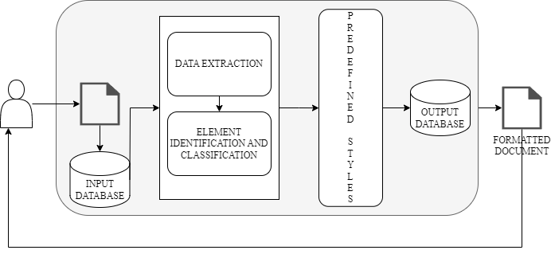
Proposed Architecture Diagram
USER
DOCUMENT
DJANGO FRAMEWORK

Slide 14
Modules
User Module
Registration and Authentication: Allowing users to create accounts and log in securely.
User Profile Management: Allowing users to update their profiles, including names, email addresses, and passwords.
File Upload and Download: Enabling users to upload Word documents and download formatted documents.

Slide 15
Input and Processing Module
File Upload Handling: Receiving and validating uploaded Word documents.
Data Extraction: Extracting data from Word documents, including text and document structure.
Data Preprocessing: Cleaning and formatting extracted data, removing extra spaces, and ensuring data consistency.

Slide 16
Predefined Style Application Module
Layout Adjustment: Ensuring that the document layout complies with research paper standards.
Style Consistency: Applying consistent styles throughout the document by using regular expressions.
Output Module
Formatted Document Generation: Generating a properly formatted Word document with the applied styles.
File Download Handling: Serving the formatted document to users for download.

Slide 17
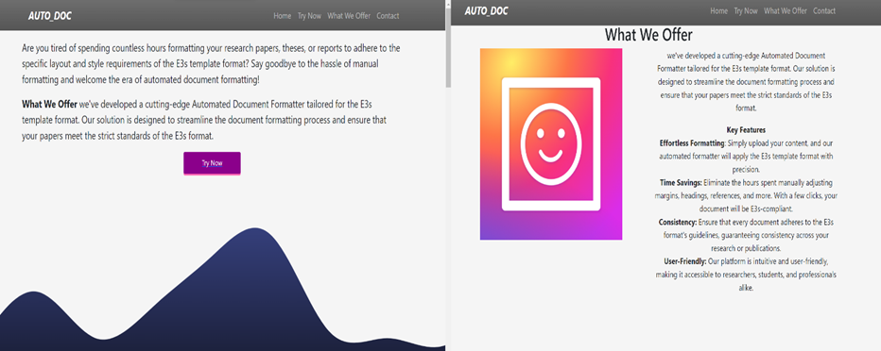
EXECUTION
The above image illustrates how the user interface is provided to the user.

Slide 18
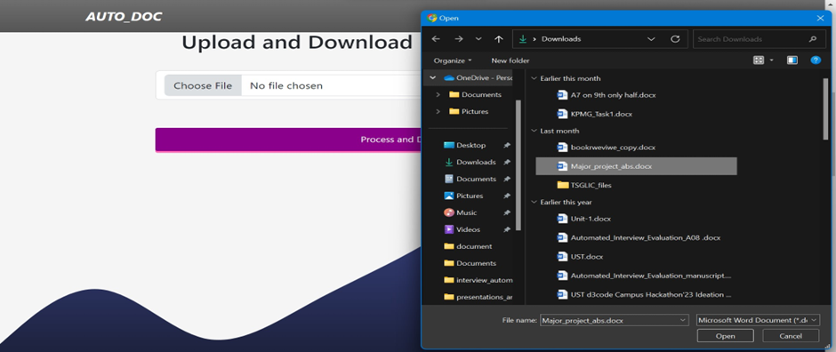
The above process shows how to upload a document file of the user.

Slide 19
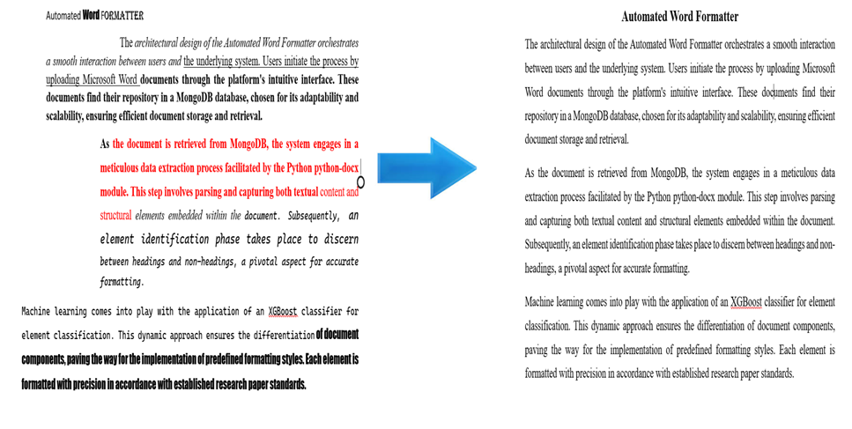
A sample on how the project works taking the raw document and converting it into a Formatted document

Slide 20
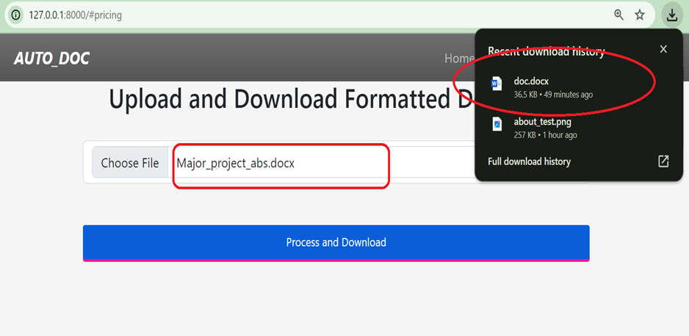
Once the document is uploaded the formatted document will be automatically downloaded as illustrated above.

Slide 21
Conclusions
The Automated Word Formatter stands as a transformative solution, rendering document formatting a hassle-free. Users experience seamless formatting magic by effortlessly uploading their documents to the platform. This marks a significant shift, making the once tedious task of formatting documents a breeze. One of the standout features is the platform's commitment to delivering an effortless formatting experience.

Slide 22
FUTURE ENHANCEMENTS
These advancements can be addressed ahead in future
Additional Document Formats: Extend support beyond DOCX to include other popular document formats, ensuring a broader user base.
Collaborative Editing: Implement collaborative editing features to enable multiple users to work on a document simultaneously.
Enhanced Error Handling: Improve error handling mechanisms to provide users with clear feedback in case of formatting issues or document errors.

Slide 23
References
[1] Nasyrov, N., Komarov, M., Tartynskikh, P., & Gorlushkina, N. (2020). Automated formatting verification technique of paperwork based on the gradient boosting on decision trees. Procedia Computer Science, 178, 365-374.
[2] V. Venkatesan and G. Hariharan, “Automation of document formatting using Python,” J. Aquat. Sci., vol. 31, no. 4, pp. 263–269, 2023.
[3] Chuvilin, K. (2016, April). Machine learning approach to automated correction of LATEX documents. In 2016 18th Conference of Open Innovations Association and Seminar on Information Security and Protection of Information Technology (FRUCT-ISPIT) (pp. 33-40). IEEE.
[4] de Oliveira, J. B. S. (2008, September). Two algorithms for automatic document page layout. In Proceedings of the eighth ACM symposium on Document engineering (pp. 141-149).

Slide 24
[5] Hurst, N., Li, W., & Marriott, K. (2009, September). Review of automatic document formatting. In Proceedings of the 9th ACM symposium on Document engineering (pp. 99-108).
[6] Nasser, I. M., & Abu-Naser, S. S. (2017). Web Application for Generating a Standard Coordinated Documentation for CS Students' Graduation Project in Gaza Universities. International Journal of Engineering and Information Systems, 1(6), 155-167.
[7] Gange, G., Marriott, K., Moulder, P., & Stuckey, P. (2011, September). Optimal automatic table layout. In Proceedings of the 11th ACM symposium on Document engineering (pp. 23-32).
[8] Bilauca, M., Gange, G., Healy, P., Marriott, K., Moulder, P., & Stuckey, P. J. (2015). Automatic minimal-height table layout. INFORMS Journal on Computing, 27(3), 449-461.
[9]Bateman, J., Kamps, T., Kleinz, J., & Reichenberger, K. (2001). Towards constructive text, diagram, and layout generation for information presentation. Computational Linguistics, 27(3), 409-449.
[10]Bolshakov, I. A., & Gelbukh, A. (2001). Text segmentation into paragraphs based on local text cohesion. In Text, Speech and Dialogue: 4th International Conference, TSD 2001 železná Ruda, Czech Republic, September 11–13, 2001, Proceedings 4 (pp. 158-166). Springer Berlin Heidelberg.

Slide 25
[11] S. S. Paliwal, V. D, R. Rahul, M. Sharma and L. Vig, "TableNet: Deep Learning Model for End-to-end Table Detection and Tabular Data Extraction from Scanned Document Images," 2019 International Conference on Document Analysis and Recognition (ICDAR), Sydney, NSW, Australia, 2019, pp. 128-133, doi: 10.1109/ICDAR.2019.00029.
[12] Maud Ehrmann, Ahmed Hamdi, Elvys Linhares Pontes, Matteo Romanello, and Antoine Doucet. 2023. Named Entity Recognition and Classification in Historical Documents: A Survey. ACM Comput. Surv. 56, 2, Article 27 (February 2024), 47 pages. https://doi.org/10.1145/3604931
[13] Schweter, S., and Akbik, A. (2020). FLERT: Document-level features for named entity recognition. arXiv preprint arXiv:2011.06993. Link: https://arxiv.org/abs/2011.06993.
[14] Yiheng Xu, Minghao Li, Lei Cui, Shaohan Huang, Furu Wei, and Ming Zhou. 2020. LayoutLM: Pre-training of Text and Layout for Document Image Understanding. In Proceedings of the 26th ACM SIGKDD International Conference on Knowledge Discovery &amp; Data Mining (KDD '20). Association for Computing Machinery, New York, NY, USA, 1192–1200. https://doi.org/10.1145/3394486.3403172.
[15] N I Widiastuti and K E Dewi 2020 IOP Conf. Ser.: Mater. Sci. Eng. 879 012069

